Slide 1

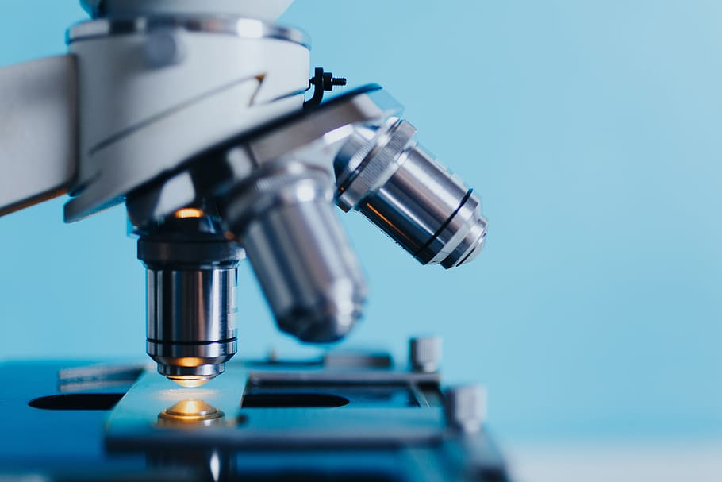
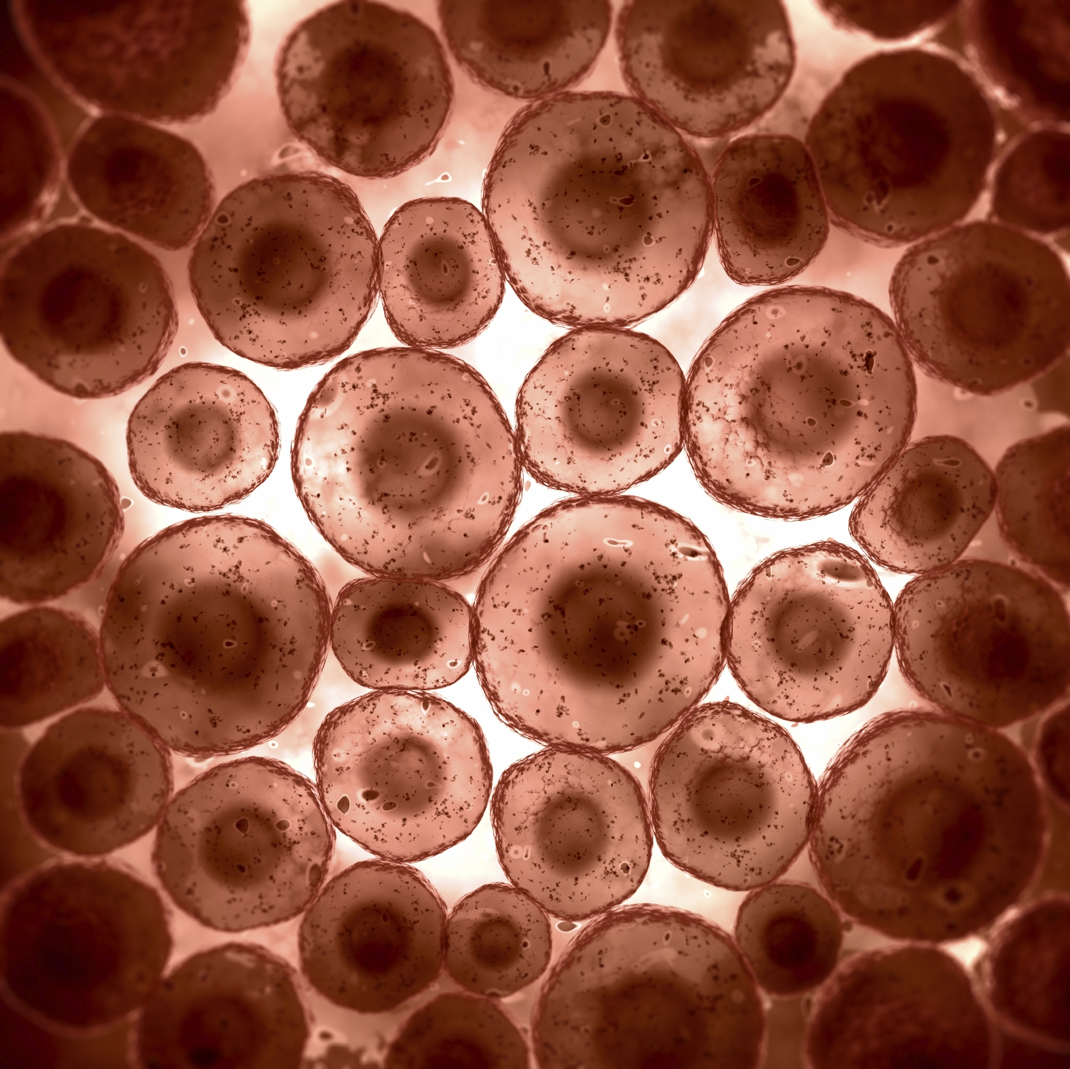
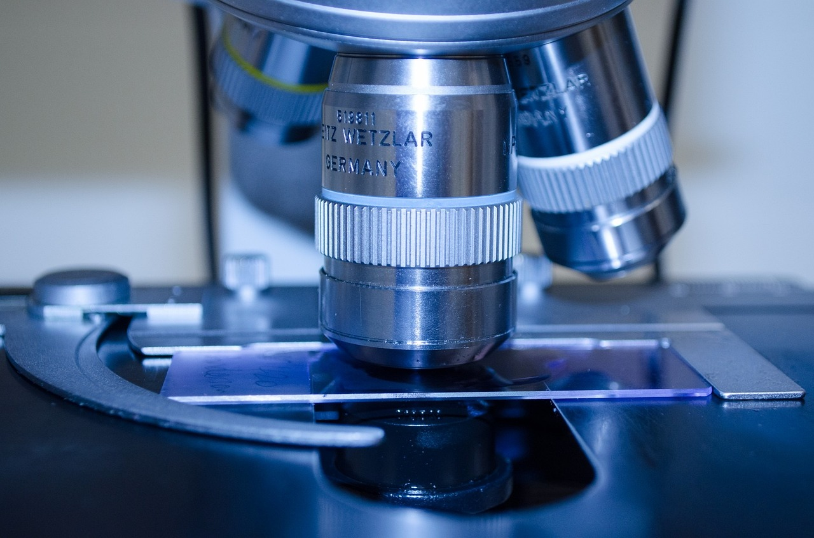
Hands-on-Training on Microscopy
2 Days Work Shop
Basic knowledge on microscopes
Different types of microscopes
Principles of Microscope
Application in project works and research activities in biological tissue samples
Sample preparation for observation under microscope
Microscopic image acquisition
(Experimental model: Rat, Mouse, Zebra fish etc.).
Exclusively for
Undergraduate, Postgraduate Research scholars (Ph.D), Teaching & Technical staffs.
Discipline:
Medical sciences, pharmacy Life/biosciences, microbiology, biochemistry, Biotechnology, and nursing etc..
Get in Touch
www.clinitree.com , +91 7848035785

Slide 2
Hands-on-Training on Microscopy
The program encompasses various methods of sample preparation for observation under microscope, assessment, microscopic image acquisition (Both live and preserved tissue) and functional aspects of microscope. Various numbers of parameters are evaluated using microscopic method to assess the alterations and deformities at cellular and sub-cellular levels. The course also encompasses inter-disciplinary and multi-disciplinary research opportunities for participants. Additionally, the course has been designed in such a way that could bridge the gap between academic study and research work in laboratory. This training program will enhance the capability of participants to carry out independent research work using microscope and skill development on appropriate handling of laboratory instruments. Those participants successfully complete the training program will receive a certificate. This course will differentiate as pioneer skills among others and get more opportunities to work in various premier institutions in India and abroad for higher education.
Mode of training: On Campus, English and Hindi

