Slide 1

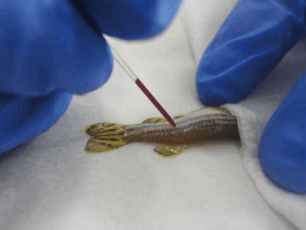
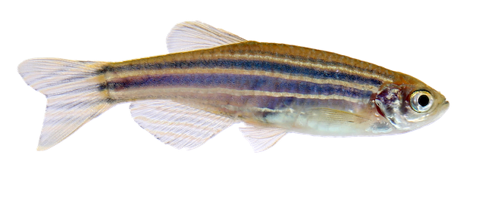
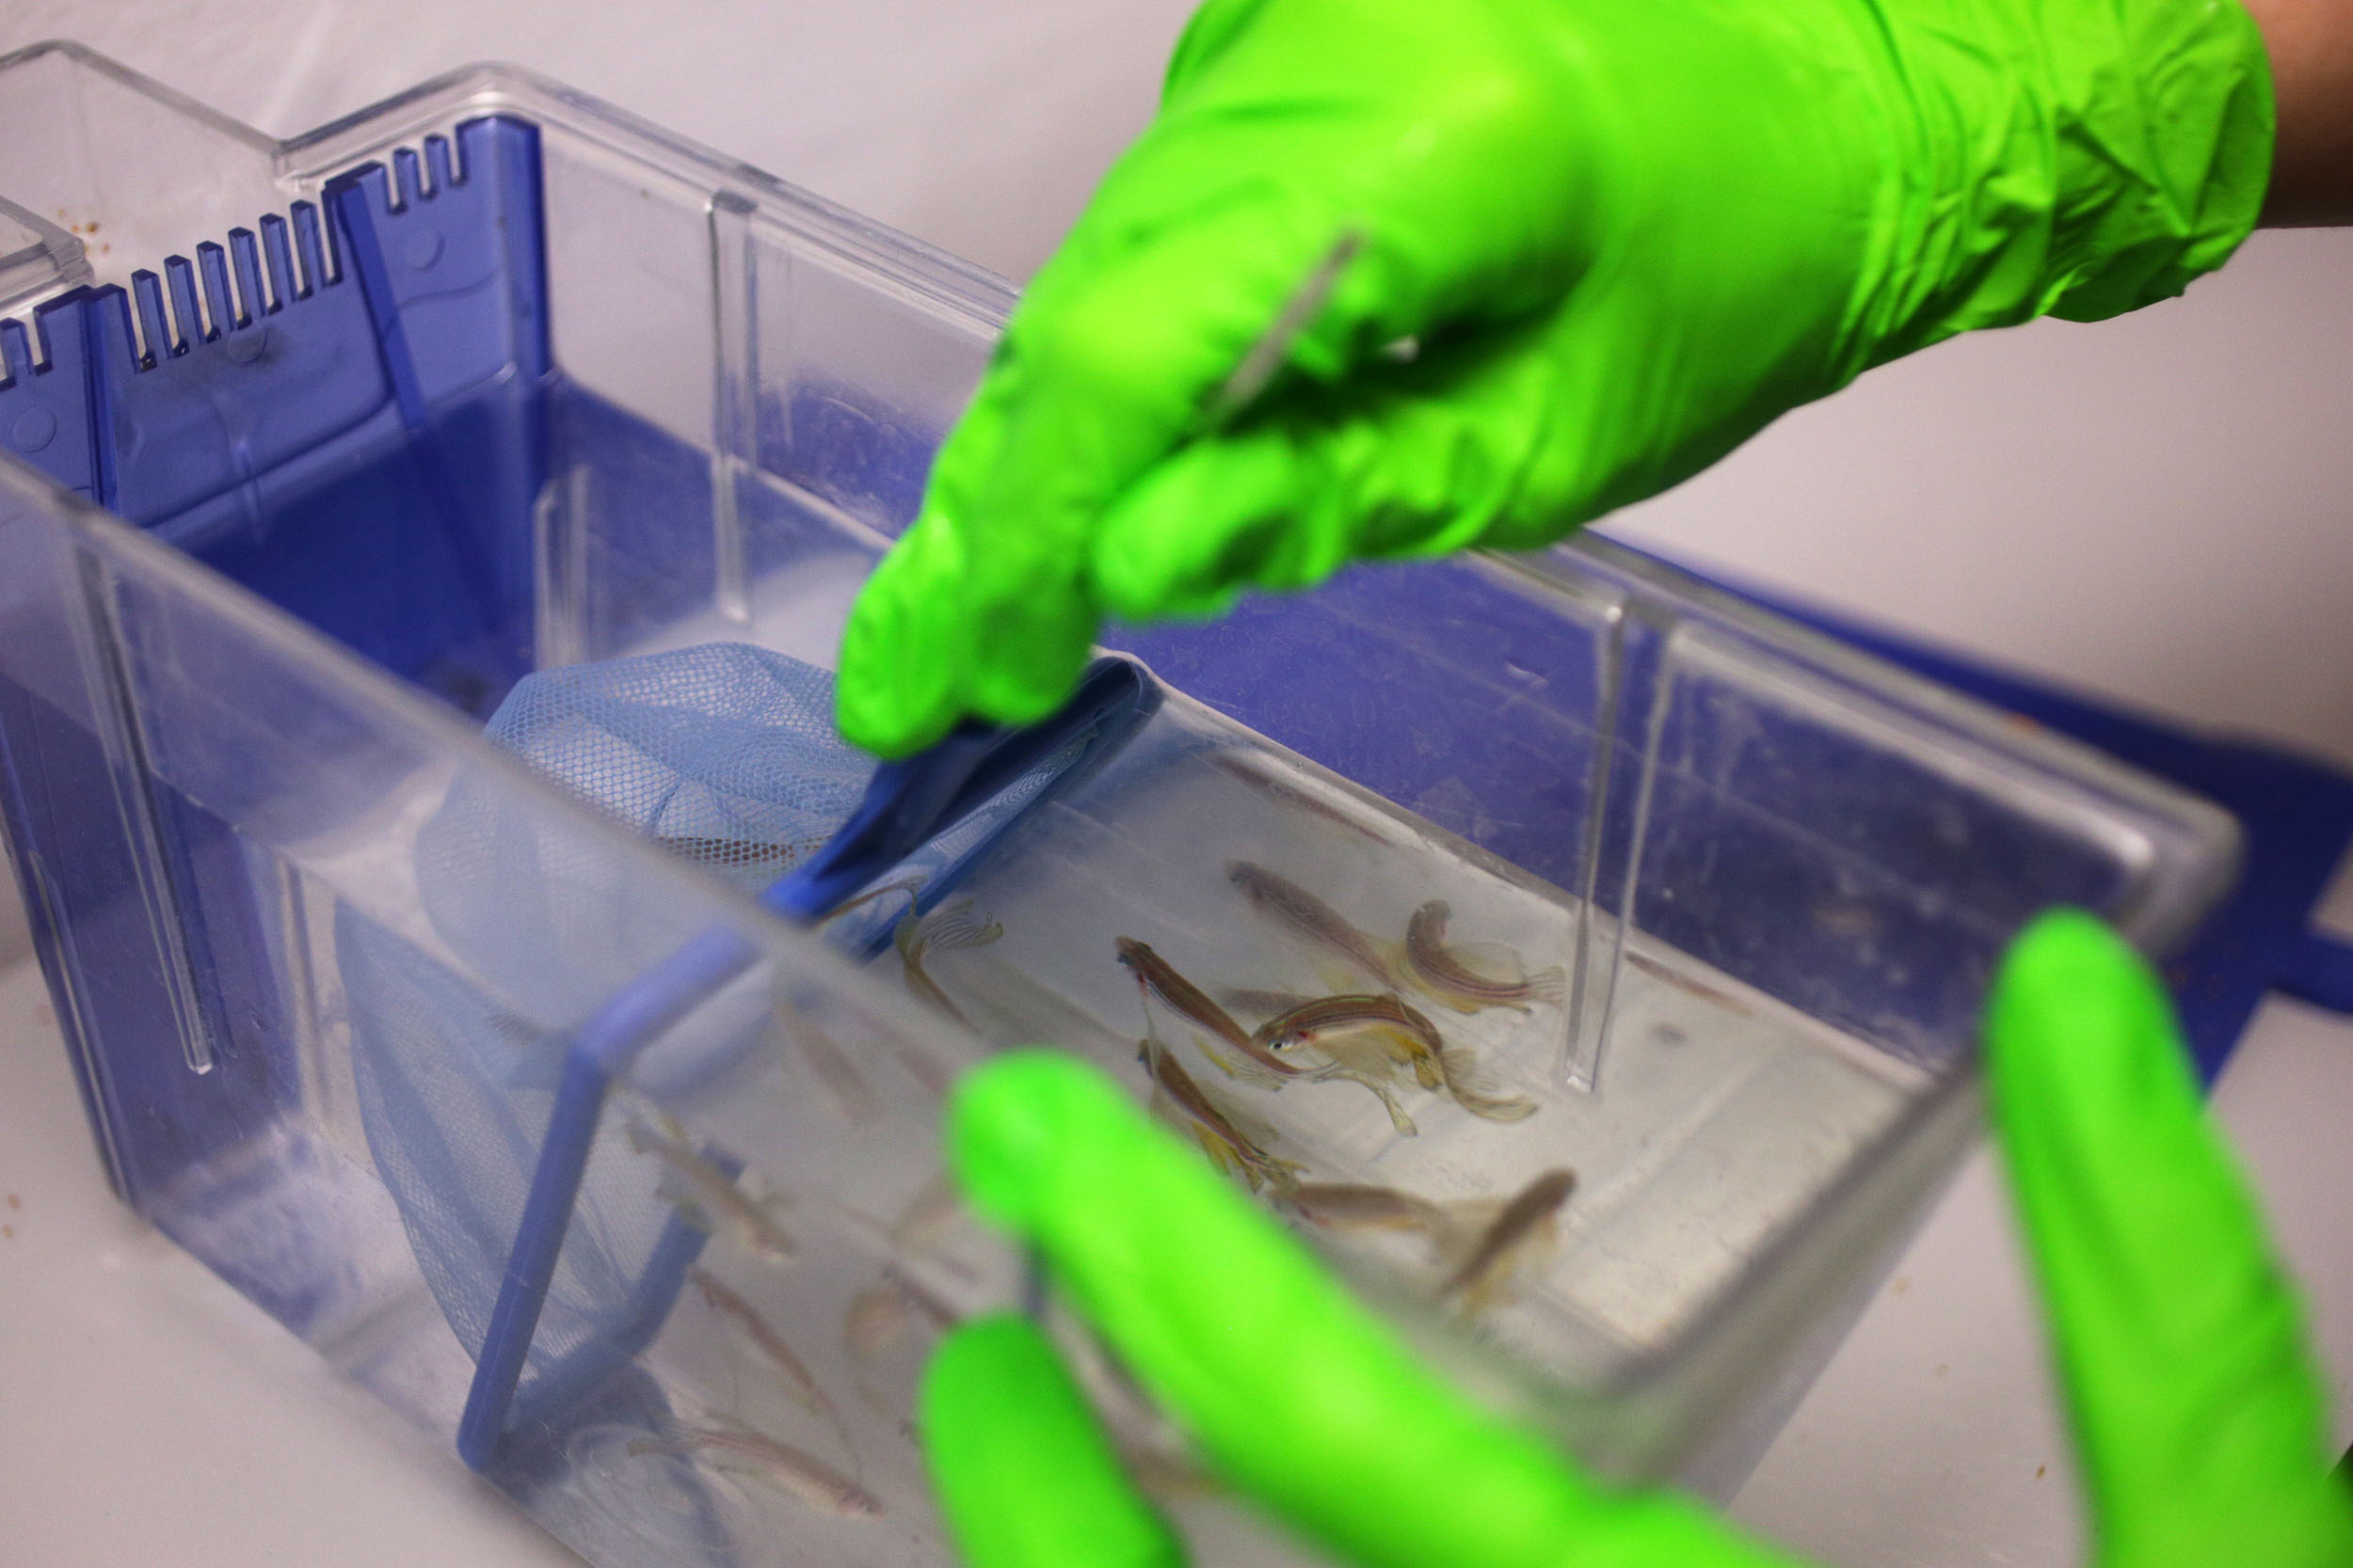
Hands - on Training on Zebrafish Handling
2 Days Work Shop
Zebrafish as a Model Organism
Zebrafish Laboratory Setup
Breeding and Maintenance
Embryo Microinjection Techniques
Zebrafish Disease Models
Toxicology and Drug Screening
Histopathological Analysis in Zebrafish
Only on
1649/-
-: Get in Touch :-
www.clinitree.com , 7848035785

